Slide 1

CircuitPython

Slide 2
What is CircuitPython?
Programming language based on Python, but with hardware support built in
“The easiest way to program micro-controllers”
Meant as an entry-point for both beginners in programming and beginners in micro-controller programming
“designed to simplify experimenting and learning to program on low-cost microcontroller boards”
fork of the MicroPython programming language originally created by Damien George
Maintained by Adafruit

Slide 3
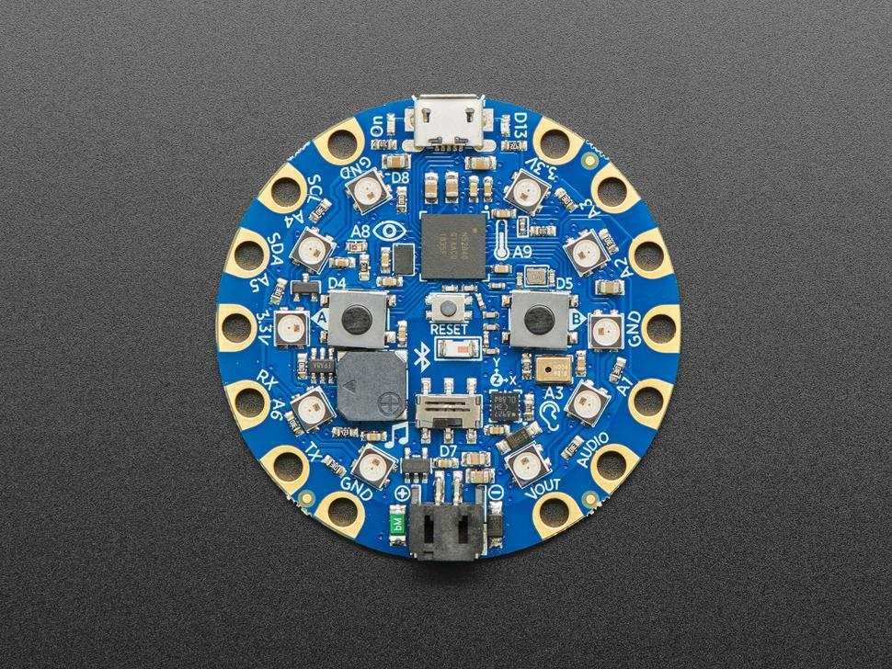
CircuitPlayground Bluefruit
- device which can run CircuitPython
- nRF52840 Cortex M4 processor with Bluetooth Low Energy support (micro controlling unit, short mcu)
- various sensors, e.g. temp, sound, light
- 10 neo pixels (leds)
- 2 MB of SPI Flash storage, used primarily with CircuitPython to store code and libraries
- MicroUSB port for programming and debugging

Slide 4
Example 1: rainbow lights when slide switch is switched on
Want to make the device switch on the leds one after each other in pastel rainbow colours
Want to do so when the slide switch is switched on

Slide 5
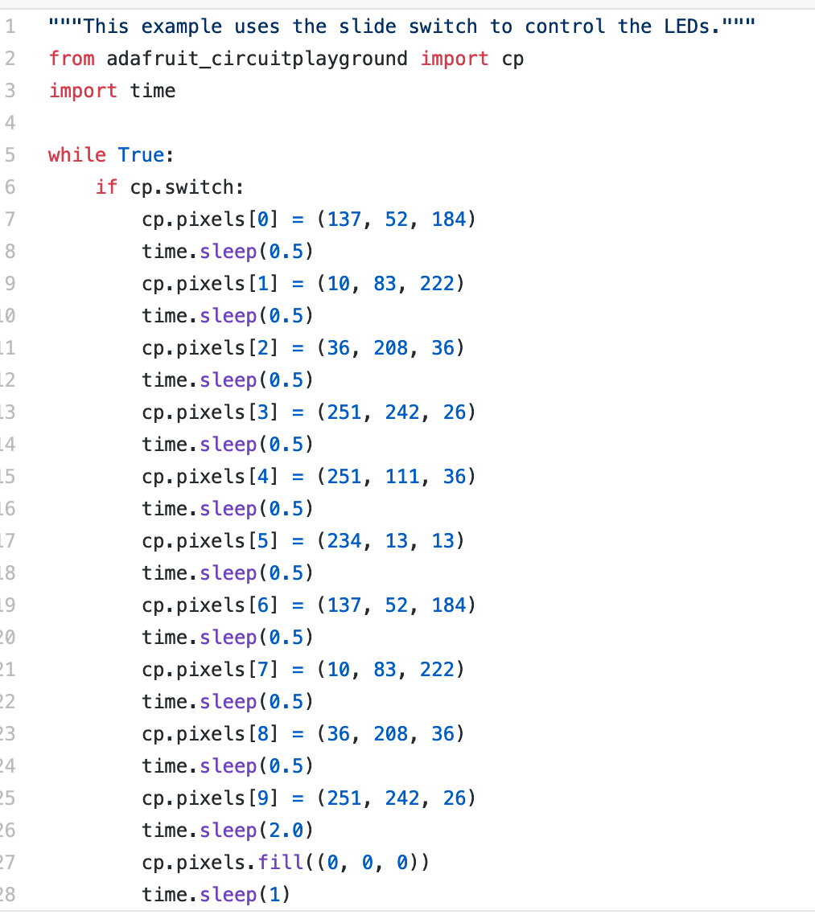
Code

Slide 6
Useful Links and Resources
https://circuitpython.org/ -> official homepage of the project
https://github.com/Adafruit/CircuitPython -> github repo
https://learn.adafruit.com/welcome-to-circuitpython/what-is-circuitpython -> nice beginner guide with instructions and examples
https://www.adafruit.com/product/4333 -> circuit playground bluefruit

